Slide 1
Statistics: A Tool For Social Research
Eleventh Edition
Joseph F. Healey

Slide 2
Measures of Central Tendency
Chapter 3

Slide 3
Learning Objectives
Explain the purposes of measures of central tendency and interpret the information they convey.
Calculate, explain, and compare and contrast the mode, median, and mean.
Explain the mathematical characteristics of the mean.
Select an appropriate measure of central tendency according to level of measurement and skew.
Use SPSS to produce means, medians, and modes.

Slide 4
Chapter Outline
The Mode
The Median
Other Measures of Position: Percentiles, Deciles, and Quartiles
The Mean
Three Characteristics of the Mean
Choosing a Measure of Central Tendency

Slide 5
In This Presentation
Three statistics:
  Mode
  Median
  Mean
You will learn how to compute and interpret each statistic
In addition, we will cover some of the most important characteristics of the mean

Slide 6
Measures of Central Tendency
Univariate descriptive statistics
Summarize information about the most typical, central, or common score of a variable

Slide 7
Central Tendency: Three Measures
Mode: The most common score
Median: The score of the middle case
Mean: The average score

Slide 8
Central Tendency Measures: Characteristics
Mode median, and mean are three different statistics
They report three different kinds of information and will have the same value only in certain situations
They vary in terms of:
  Level-of-measurement considerations
  How they define central tendency

Slide 9
Mode
The most common score
Can be used with variables at all three levels of measurement
Most often used with nominal level variables

Slide 10
Finding the Mode
Count the number of times each score occurred
The score that occurs most often is the mode
  If the variable is presented in a frequency distribution, the mode is the largest category
  If the variable is presented in a line chart, the mode is the highest peak

Slide 11
Finding the Mode: Example
Top Ten U.S Cities Visited by Overseas Travelers, 2010
City | Number of Visitors
Boston | 1,186,000
Chicago | 1,134,000
Las Vegas | 2,425,000
Los Angeles | 3,348,000
Miami | 3,111,000
New York City | 8,462,000
Oahu/Honolulu | 1,634,000
Orlando | 2,750,000
San Francisco | 2,636,000
Washington, D.C. | 1,740,000
Source: U.S. Bureau of the Census. 2012. Statistical Abstract of the United States: 2012. p. 774 Retrieved from http://www.census.gov/prod/2011pubs/12statab/arts.pdf.

Slide 12
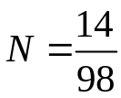

Limitations of Mode
Some distributions have no mode
Some distributions have multiple modes
The mode of an ordinal or interval-ratio level variable may not be central to the whole distribution
Distributions of Scores on Two Tests
 | Test A | Test B
Score (% correct) | Frequency of scores | Frequency of scores
97 | 14 | 22
91 | 14 | 3
90 | 14 | 4
86 | 14 | 22
77 | 14 | 3
60 | 14 | 22
55

Slide 13
Median (Md)
Exact center of distribution of scores
The score of the middle case
Can be used with variables measured at the ordinal or interval-ratio levels
Cannot be used for nominal level variables

Slide 14
Finding the Median
Array the cases from low to high (or from high to low)
Locate the middle case
  If N is odd: the median is the score of the middle case
  If N is even: the median is the average of the scores of the two middle cases

Slide 15
Finding the Median: Example 1
TABLE 3.4 Finding the Median with Seven Cases (N is odd)
Case | Score
A | 10
B | 10
C | 8
D | 7 | ← Md
E | 5
F | 4
G | 2

Slide 16
Finding the Median: Example 2
TABLE 3.5 Finding the Median with Eight Cases (N is even)
Case | Score
A | 10
B | 10
C | 8
D | 7
 |  | ← Md = (7 + 5)/2 = 6
E | 5
F | 4
G | 2
H | 1

Slide 17
Finding the Median: Example 3
Robbery Rate for 7 Cities
Atlanta | 1037.8
Chicago | 668.0
Dallas | 582.8
San Francisco | 444.9
Los Angeles | 420.2
Boston | 416.0
New York | 406.6

Slide 18
Finding the Median: Example 3
How would the median change if we added an 8th case?
  San Diego had a robbery rate of 145.3.
There are now two middle cases, so the median is the average of the scores of the two middle cases:
  (444.9 + 420.2)/2 = 432.55

Slide 19
Other Measures of Position (1 of 3)
Percentiles: point below which a specific percentage of cases fall
Deciles: divides distribution into Elevenths (10, 20, 30, ... 90)
Quartiles: divides distribution into quarters (25, 50, 75)
Example: The 6th decile (or 60th percentile) for a sample of 70 test grades is 85, which tells us that 60% of students scored below 85 on the test
The median falls at the 50th percentile (or the 5th decile or the 2nd quartile)

Slide 20
Other Measures of Position (2 of 3)
To calculate a percentile:
Arrange scores in order from low to high
Multiply the number of cases (N) by the proportional value of the percentile (for example: the 75th percentile would be 0.75)
The resultant value marks the number of the case that falls at the percentile

Slide 21
Other Measures of Position (3 of 3)
Examples:
  In a sample of 70 test grades we want to find the 4th decile (or 40th percentile), 70 × 0.40 = 28, so the 28th case is the 40th percentile
  In a sample of 70 test grades we want to find the 3rd quartile (or 75th percentile), 70 × 0.75 = 52.5, rounding to 53 the 53rd case is the 75th percentile

Slide 22
Mean
The average score
Requires variables measured at the interval-ratio level but is often used with ordinal-level variables
Cannot be used for nominal-level variables
The mean or arithmetic average, is by far the most commonly used measure of central tendency

Slide 23
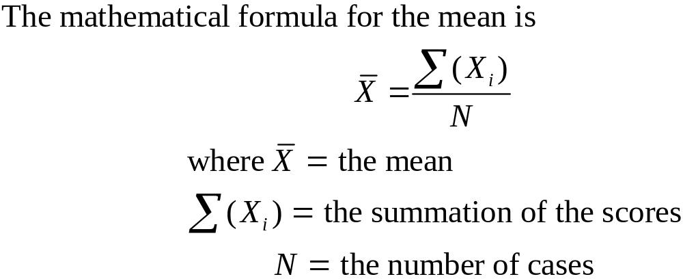
Finding the Mean
To calculate: add all of the scores and then divide by the number of scores (N )

Slide 24
Finding the Mean: Example
Atlanta | 1037.8
Chicago | 668.0
Dallas | 582.8
San Francisco | 444.9
Los Angeles | 420.2
Boston | 416.0
New York | 406.6
Total | 4121.6
Robbery Rate for 7 Cities
The mean is 4121.6/8 = 515.2
These cities averaged 515.2 robberies per 100,000 population.

Slide 25


Three Characteristics of the Mean
The mean “balances” out all of the scores in a distribution; all scores “cancel out” around the mean
The mean is the point of minimized variation of the scores, “least squares principle”
The mean is affected by all scores; all scores are used in the calculation of the mean

Slide 26


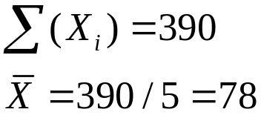

The Mean “Balances Out” All Scores
A Demonstration Showing That All Scores Cancel Out Around the Mean
65 | 65 − 78 = −13
73 | 73 − 78 = −5
77 | 77 − 78 = −1
85 | 85 − 78 = 7
90 | 90 − 78 = 12

Slide 27








The Mean Is the Point of Minimized Variation
A Demonstration Showing That the Mean Is the Point of Minimized Variation
1 | 2 | 3 | 4
65 | 65 − 78 = −13 | (−13)² = 169 | 65 − 77 = (−12)² = 144
73 | 73 − 78 = −5 | (−5)² = 25 | 73 − 77 = (−4)² = 16
77 | 77 − 78 = −1 | (−1)² = 1 | 77 − 77 = (0)² = 0
85 | 85 − 78 = 7 | (7)² = 49 | 85 − 77 = (8)² = 64
90 | 90 − 78 = 12 | (12)² = 144 | 90 − 77 = (13)² = 169

Slide 28
The Mean is Affected by All Scores
A Demonstration Showing That the Mean Is Affected by Every Score
1 | 2 | 3 | 4 | 5 | 6
Scores | Measures of Central Tendency | Scores | Measures of Central Tendency | Scores | Measures of Central Tendency
15 | Mean = 25 | 15 | Mean = 718 | 0 | Mean = 22
20 |  | 20 |  | 20
25 | Median = 25 | 25 | Median = 25 | 25 | Median = 25
30 |  | 30 |  | 30
35 |  | 3500 |  | 35

Slide 29
The Mean is Affected by All Scores
Strength - The mean uses all the available information from the variable
Weaknesses
  The mean is affected by every score
  If there are some very high or low scores (as with skewed distributions), the mean may be misleading

Slide 30
Finding the Mean: Example
Maryland | 9.8
Maine | 9.5
Iowa | 8.7
New Jersey | 9.3
Texas | 21.5
Total | 58.8
% Of Children Not Covered by Health Insurance

Slide 31
Finding the Mean: Example
4 of 5 states have very similar scores but Texas is much higher
The mean = 58.8/5 = 11.76
4 of the 5 states have scores between 8.7 and 9.8, lower than 11.76
Is 11.76 a useful summary of central tendency for these states?

Slide 32
Means, Medians, and Skew (1 of 3)
When a distribution has a few very high or low scores, the mean will be pulled in the direction of the extreme scores
  For a positive skew, the mean will be greater than the median
  For a negative skew, the mean will be less than the median
When an interval-ratio level variable has a pronounced skew, the median may be the more trustworthy measure of central tendency

Slide 33
Means, Medians, and Skew (2 of 3)
Sex Partners Over Last Year | Freq | %
0 | 511 | 22.8
1 | 1397 | 62.5
2 | 159 | 7.1
3 | 83 | 3.7
4 | 39 | 1.7
5 -10 | 34 | 1.5
11 - 20 | 10 | 0.4
21 - 100 | 2 | 0.1
100+ | 2 | 0.1

Slide 34
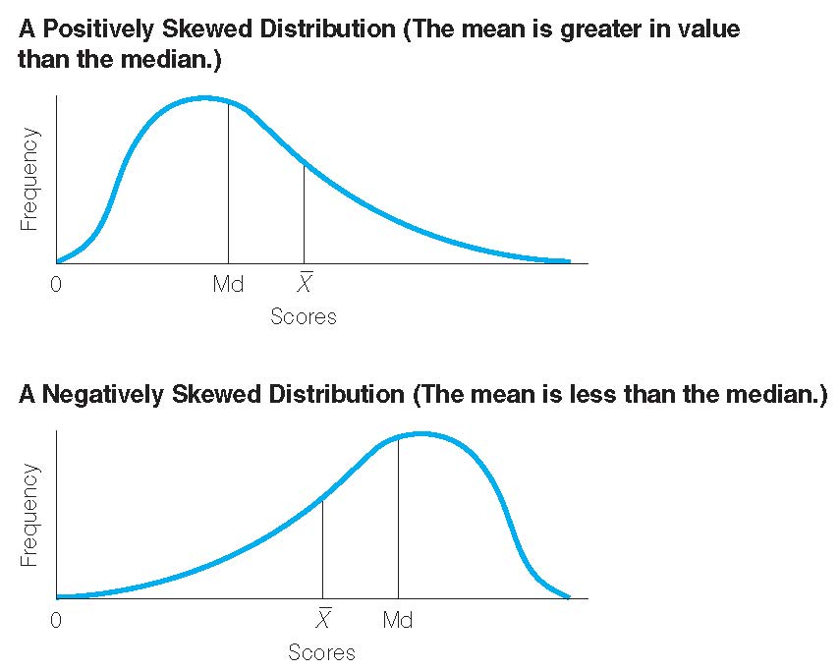
Means, Medians, and Skew (3 of 3)

Slide 35
Choosing a Measure of Central Tendency: Two Considerations
1. Level of measurement
The Relationship Between Level of Measure and Measures of Central Tendency
Measure of Central Tendency | Nominal | Ordinal | Interval-Ratio
Mode | YES | Yes | Yes
Median | No | YES | Yes
Mean | No | Yes (?) | YES
Level of Measurement

Slide 36
Choosing a Measure of Central
Tendency: Two Considerations
2. What kind of information you want
Choosing a Measure of Central Tendency
Use the mode when: | 1 The variable is measured at the nominal level. 2 You want a quick and easy measure for ordinal and interval-ratio variables. 3 You want to report the most common score. 4 You have an interval-ratio variable with two modes that are separated from one another. This is called a bimodal distribution. In this case, report both modes.
Use the median when: | 1 The variable is measured at the ordinal level. An interval-ratio variable is highly skewed. You want to report the central score. The median always lies at the exact center of the distribution
Use the mean when: | The variable is measured at the interval-ratio level (except when the variable is highly skewed). You want to report the typical score. The mean is the “fulcrum that exactly balances all of the scores.” 3 You anticipate additional statistical analysis.

